Slide 1
INTRODUCTION TO
ALGORITHMS
FOURTH EDITION

Slide 2
LECTURE NOTES FOR CHAPTER 35
Approximation Algorithms

Slide 3
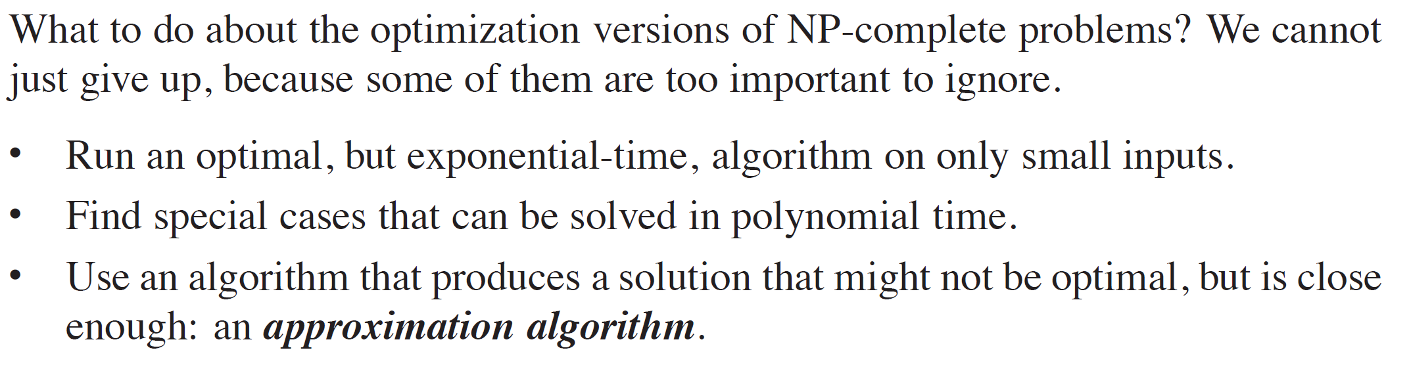
CHAPTER 35 OVERVIEW

Slide 4
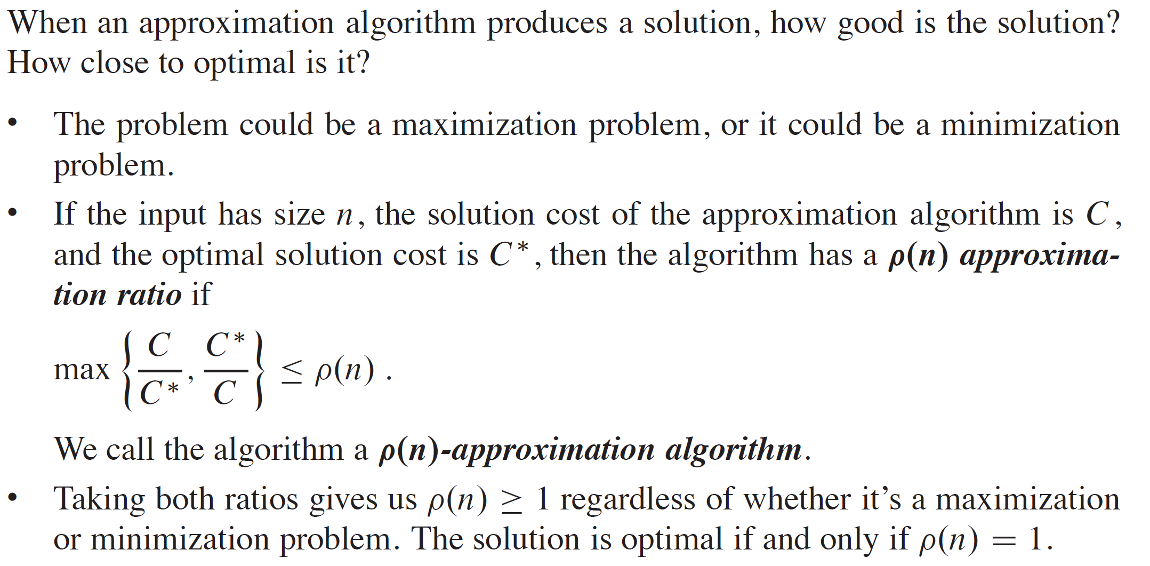
PERFORMANCE RATIOS

Slide 5
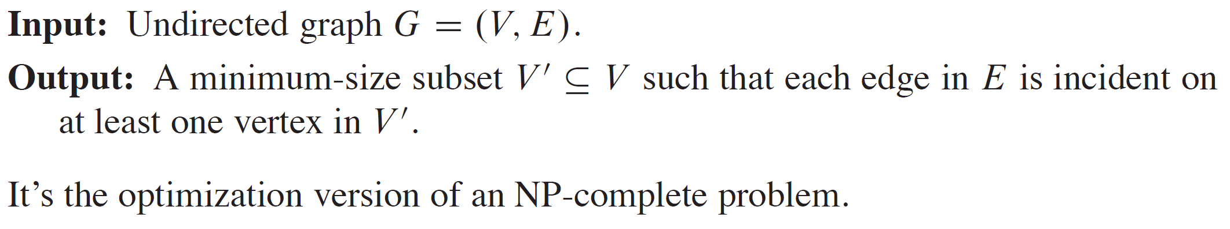
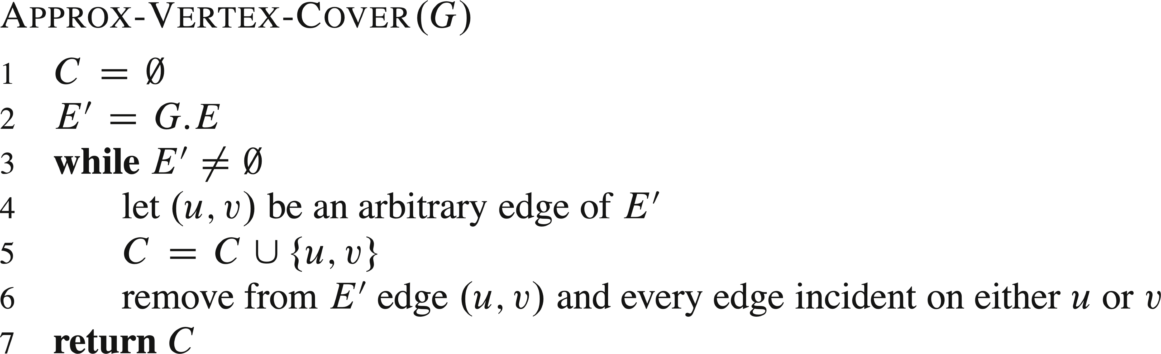
VERTEX COVER

Slide 6
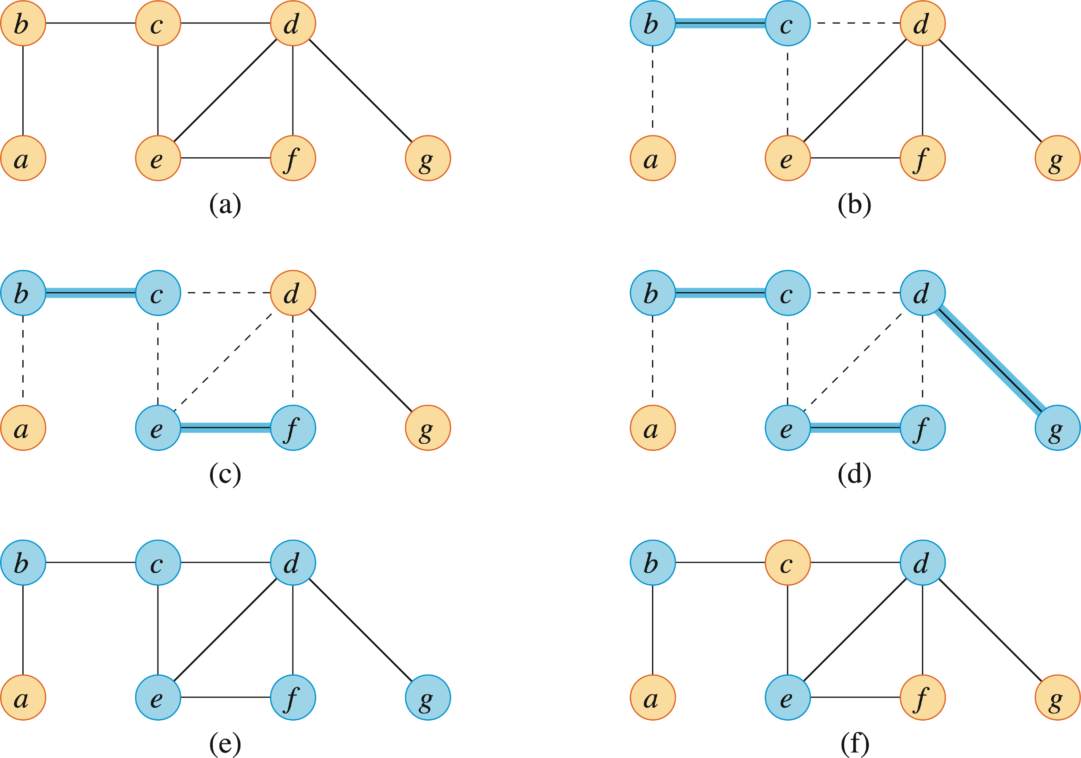
VERTEX COVER (continued)

Slide 7
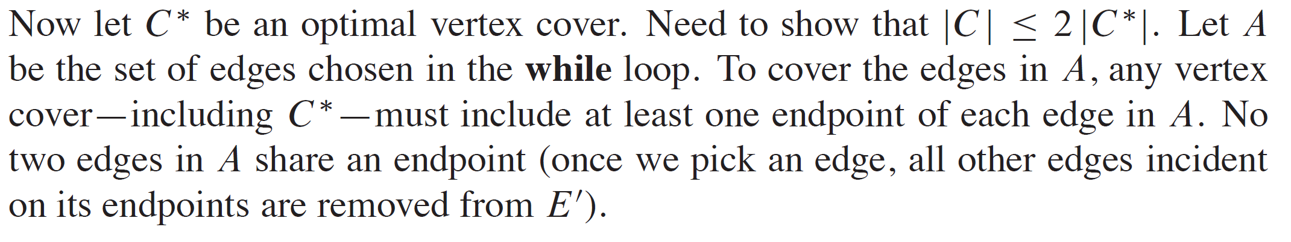
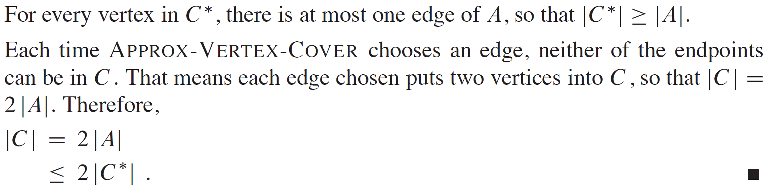
VERTEX COVER (continued)

Slide 8
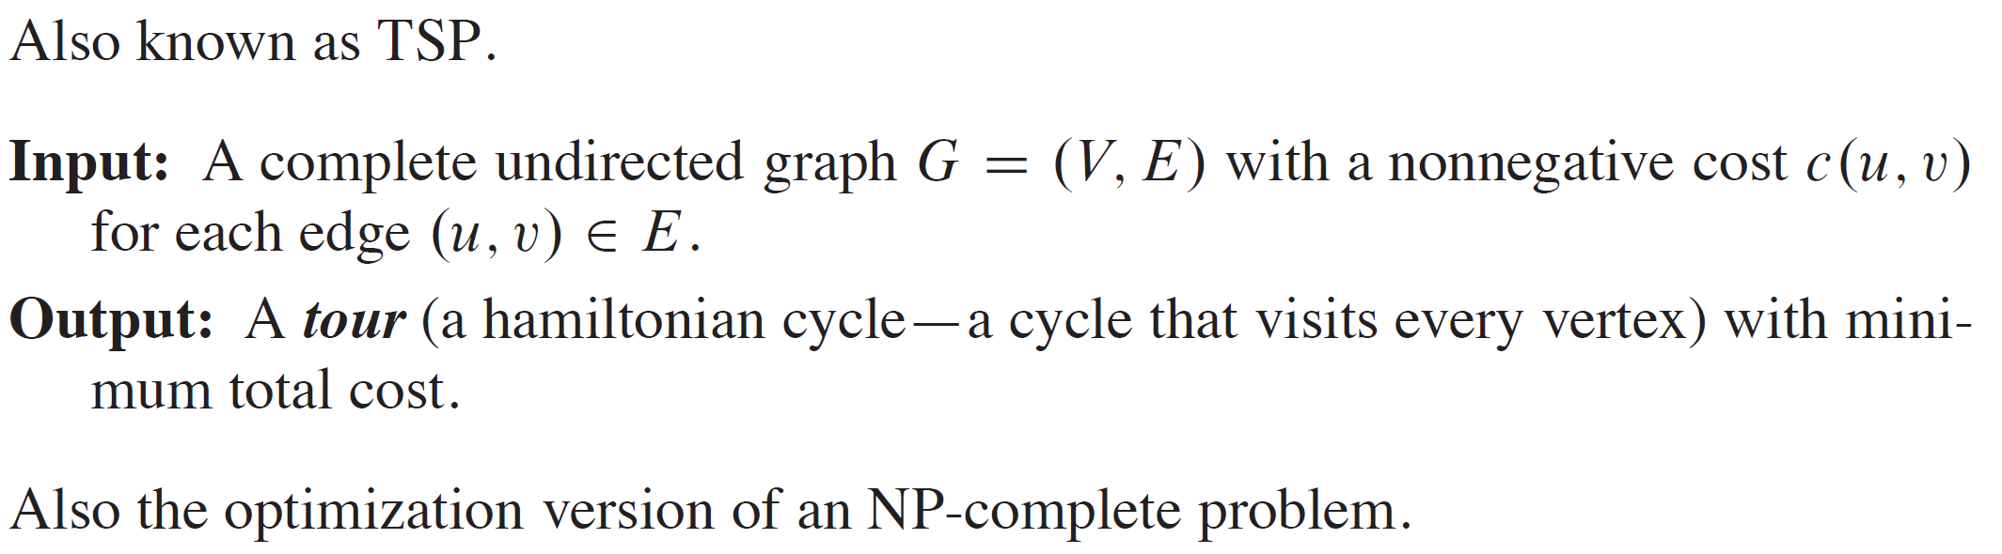
TRAVELING-SALESPERSON PROBLEM

Slide 9
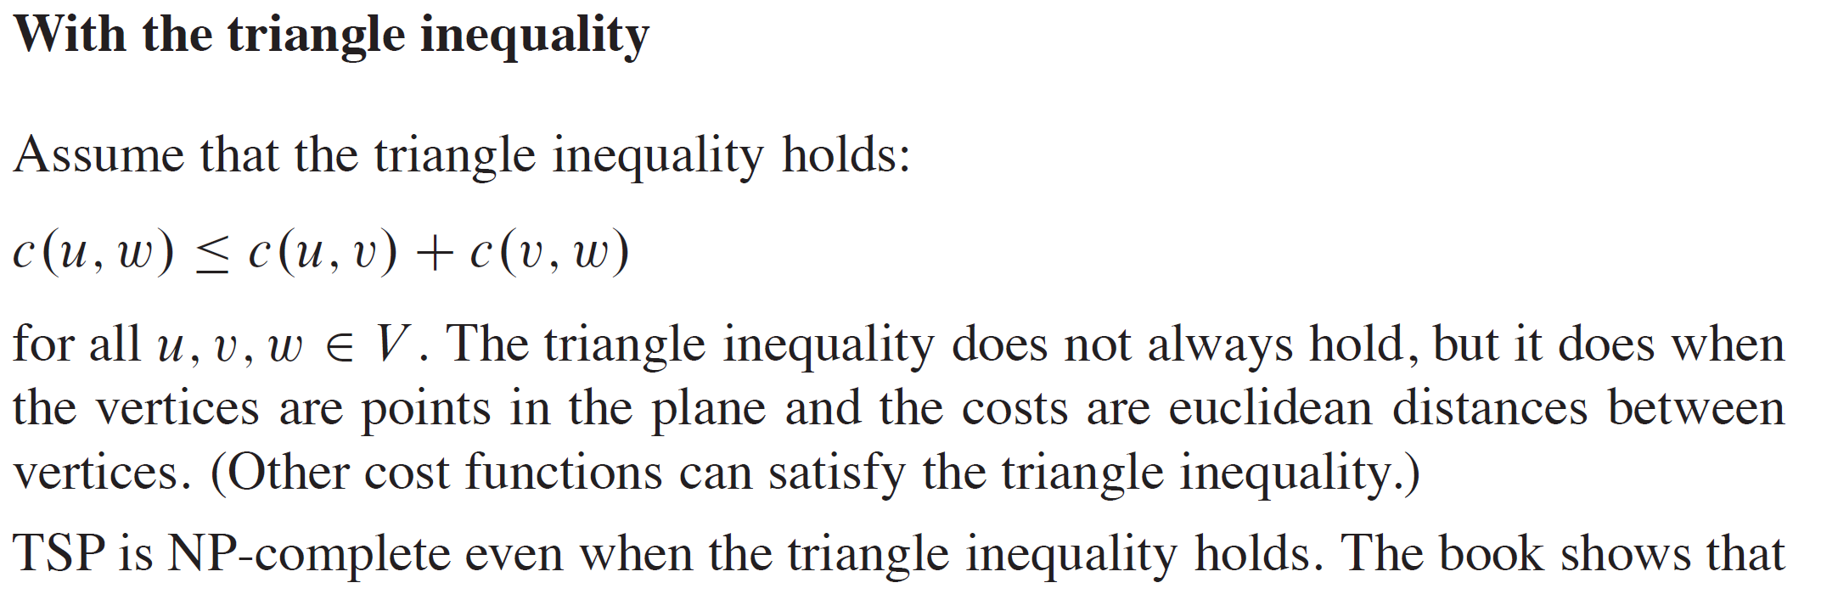
TRAVELING-SALESPERSON PROBLEM (continued)

Slide 10
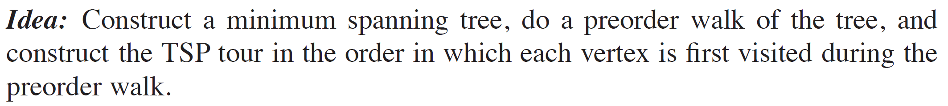
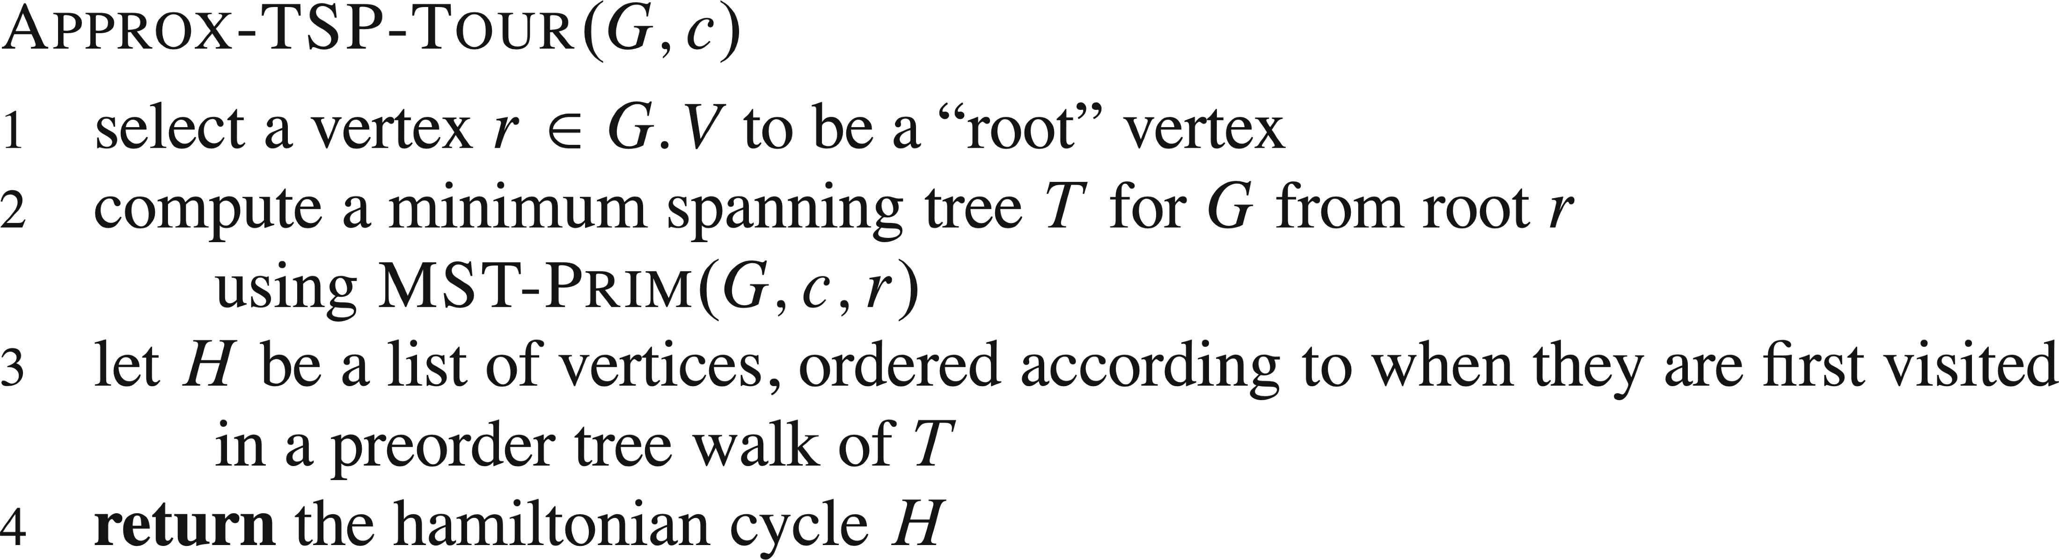
TRAVELING-SALESPERSON PROBLEM (continued)

Slide 11
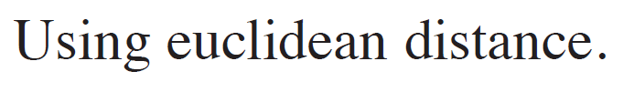
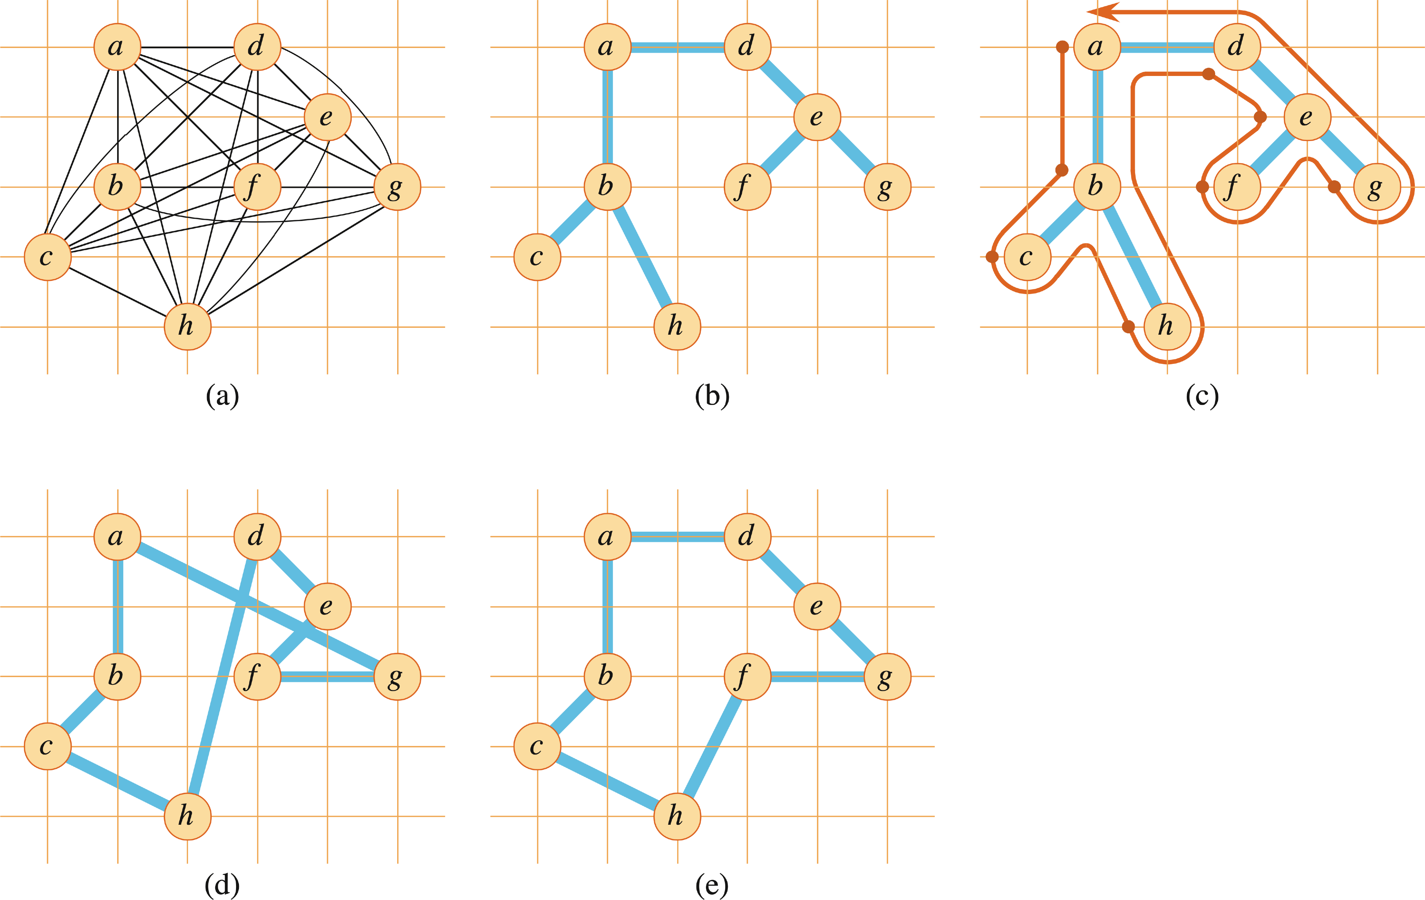
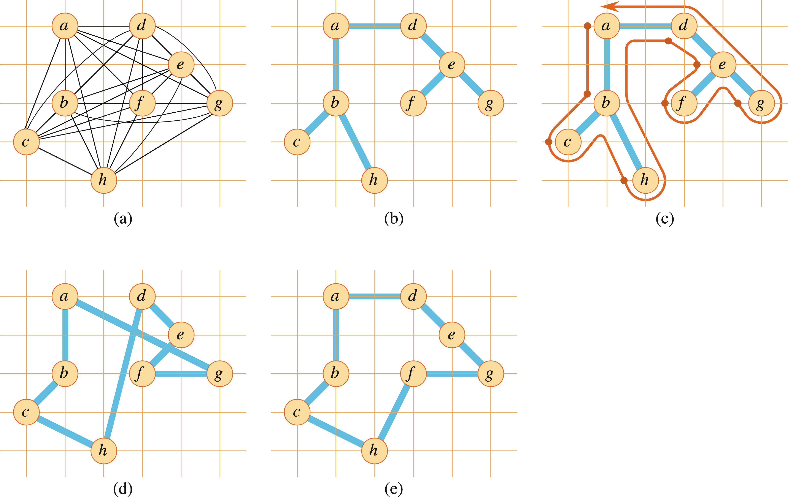
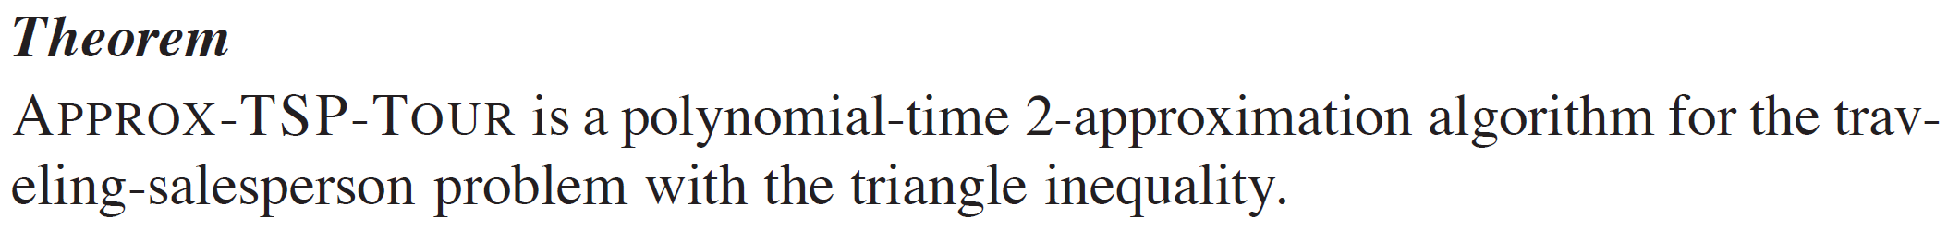
EXAMPLE

Slide 12
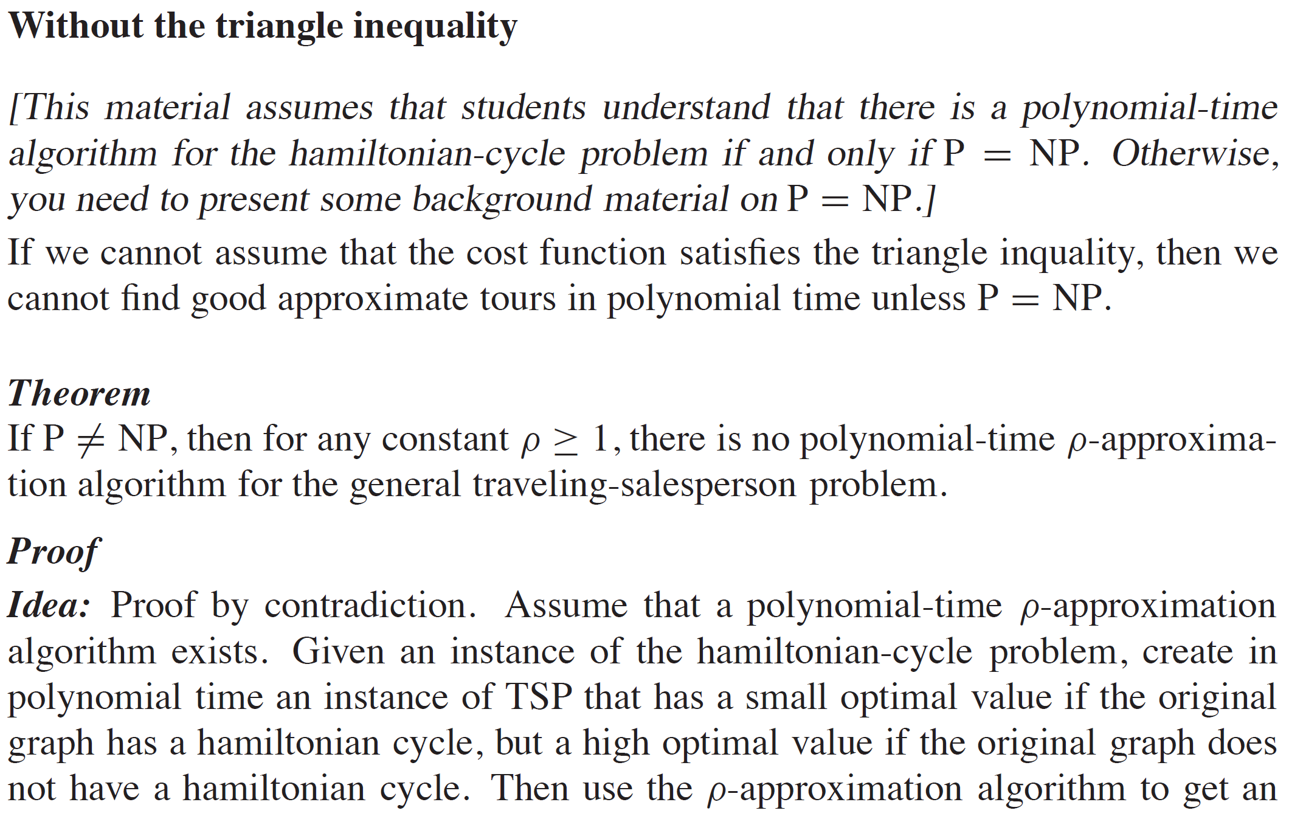
TRAVELING-SALESPERSON PROBLEM (continued)

Slide 13
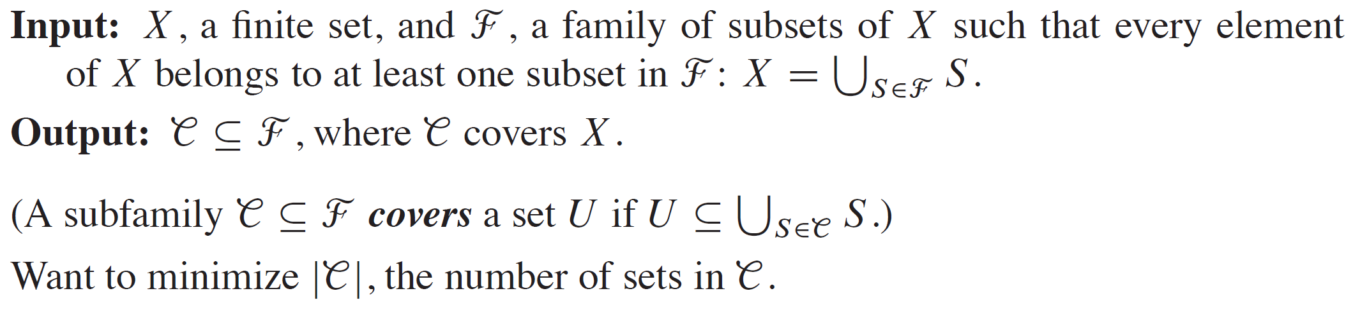
SET-COVERING PROBLEM

Slide 14
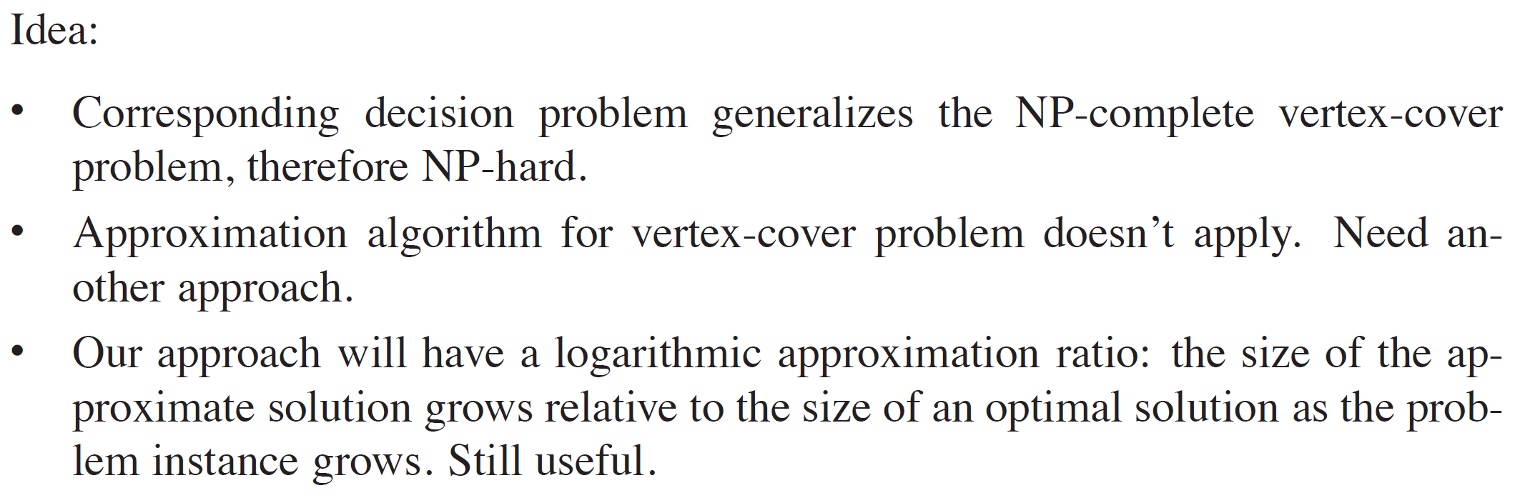
SET-COVERING PROBLEM (continued)

Slide 15
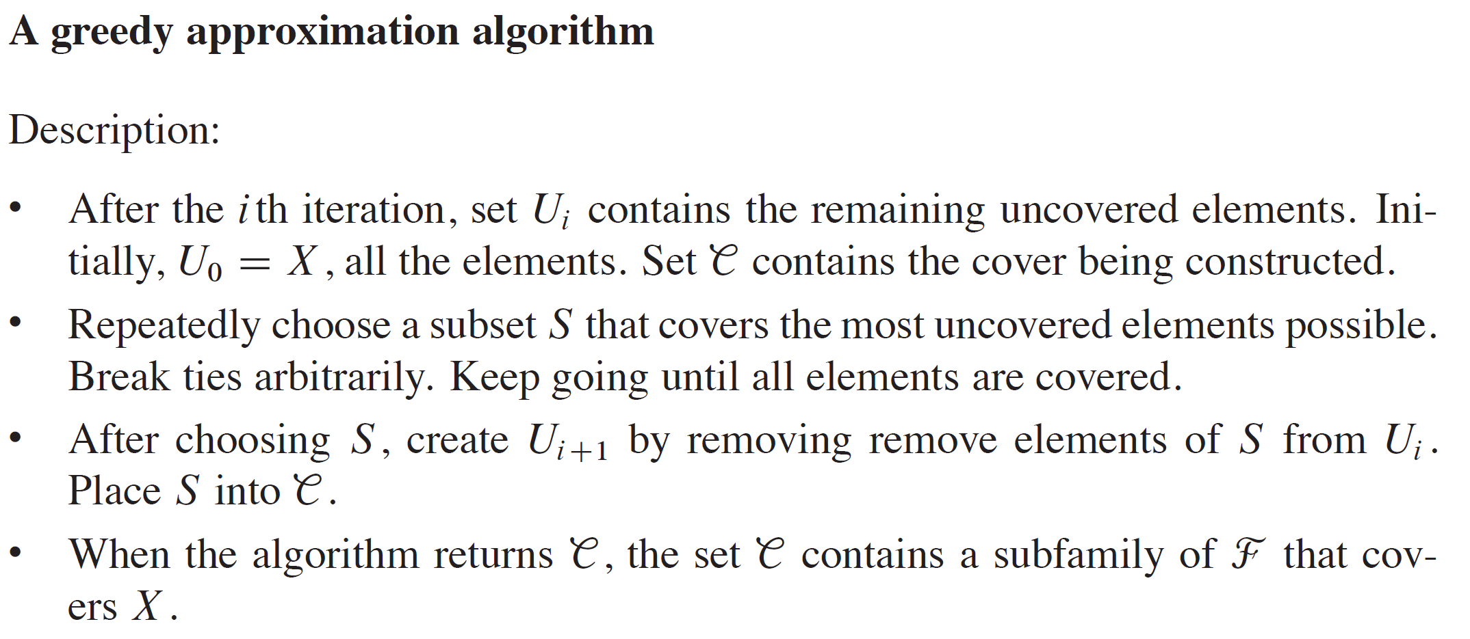
SET-COVERING PROBLEM (continued)

Slide 16
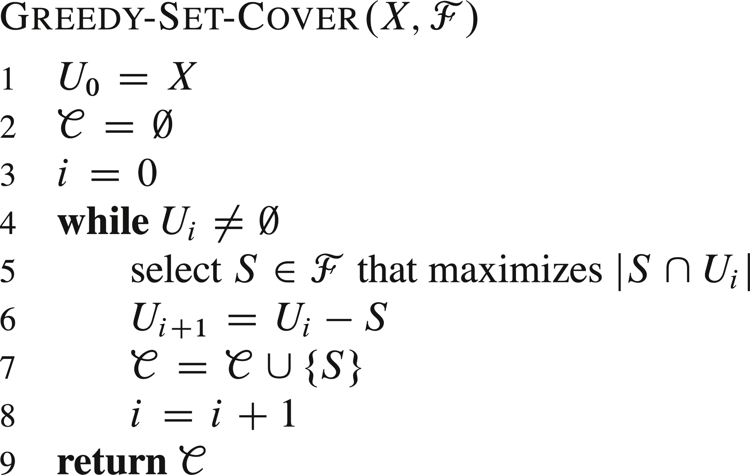
SET-COVERING PROBLEM (continued)

Slide 17
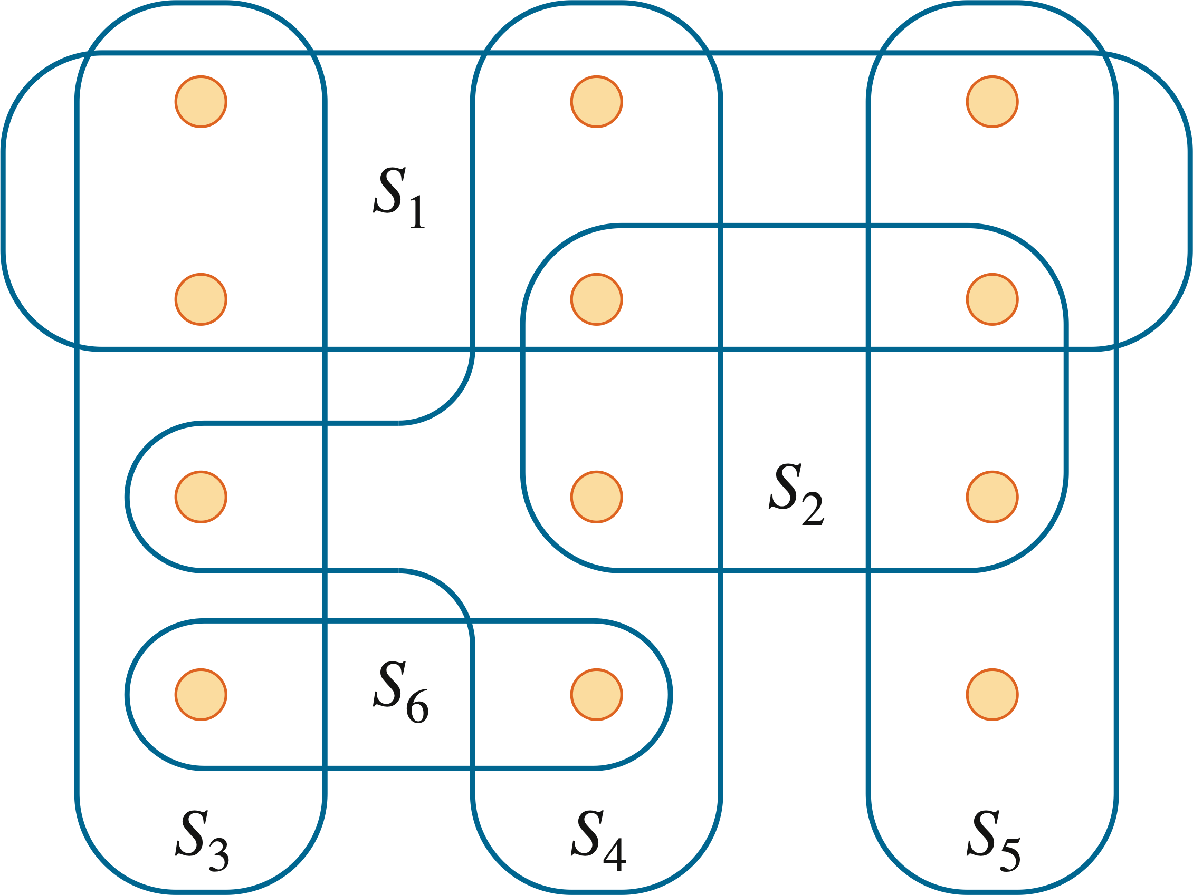
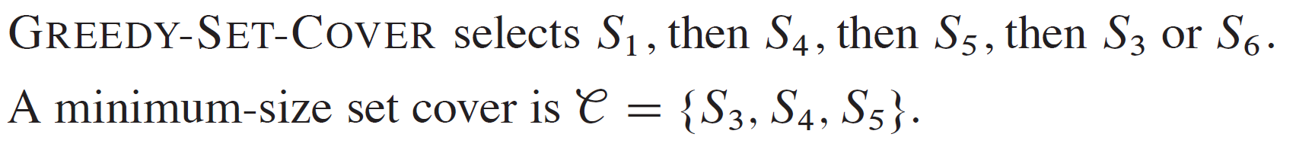
EXAMPLE

Slide 18
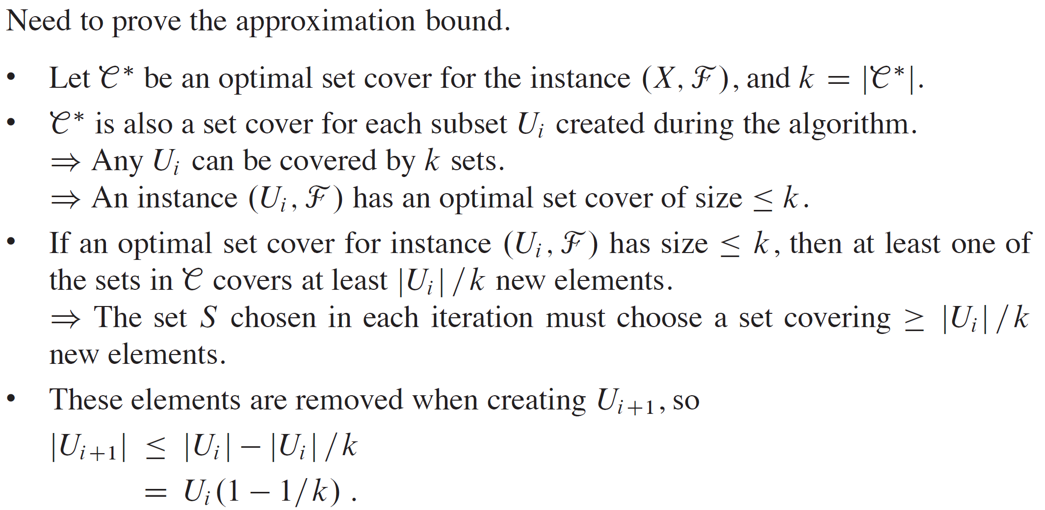
SET-COVERING PROBLEM (continued)

Slide 19
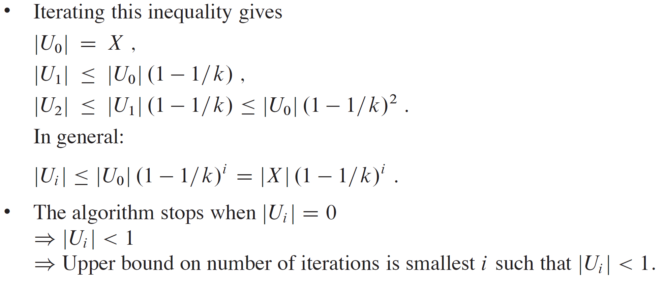

SET-COVERING PROBLEM (continued)
Notes:
Full mathematical analysis of last point given in textbook.

Slide 20
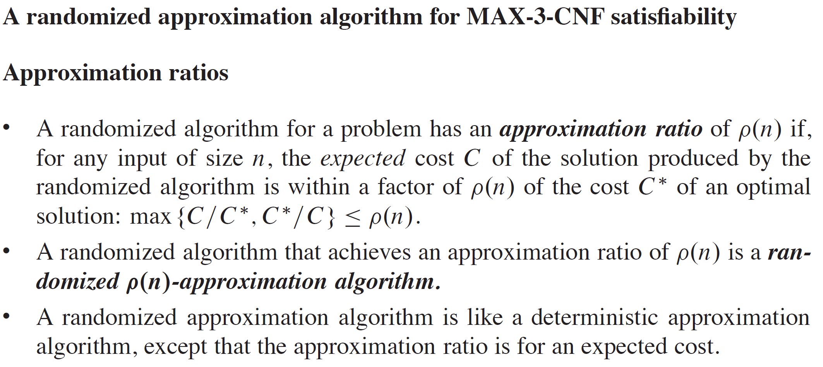
RANDOMIZATION AND LINEAR PROGRAMMING

Slide 21
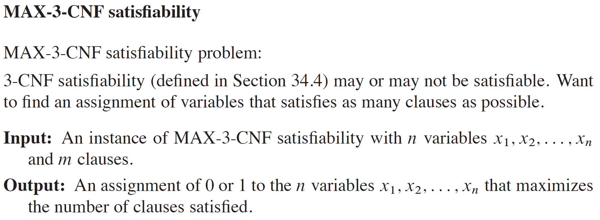
RANDOMIZATION AND LINEAR PROGRAMMING (continued)

Slide 22
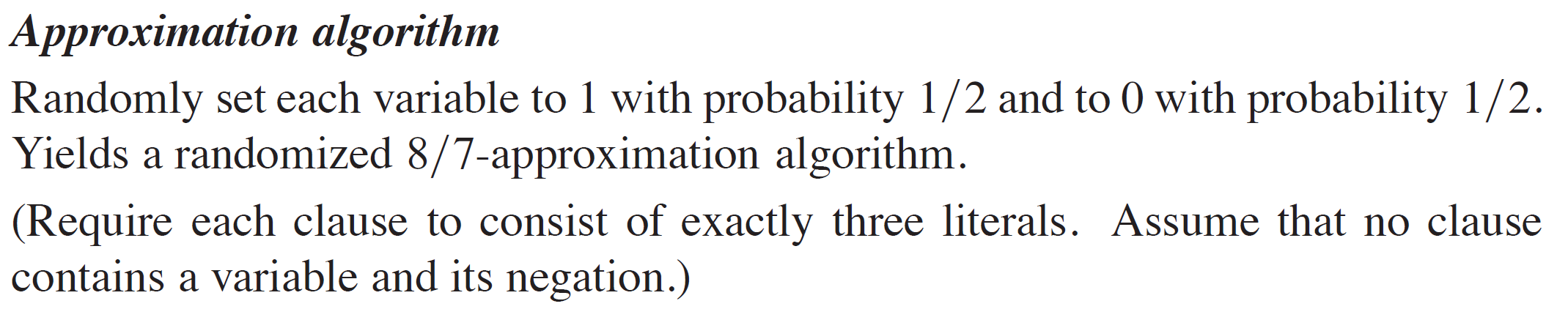
RANDOMIZATION AND LINEAR PROGRAMMING (continued)

Slide 23
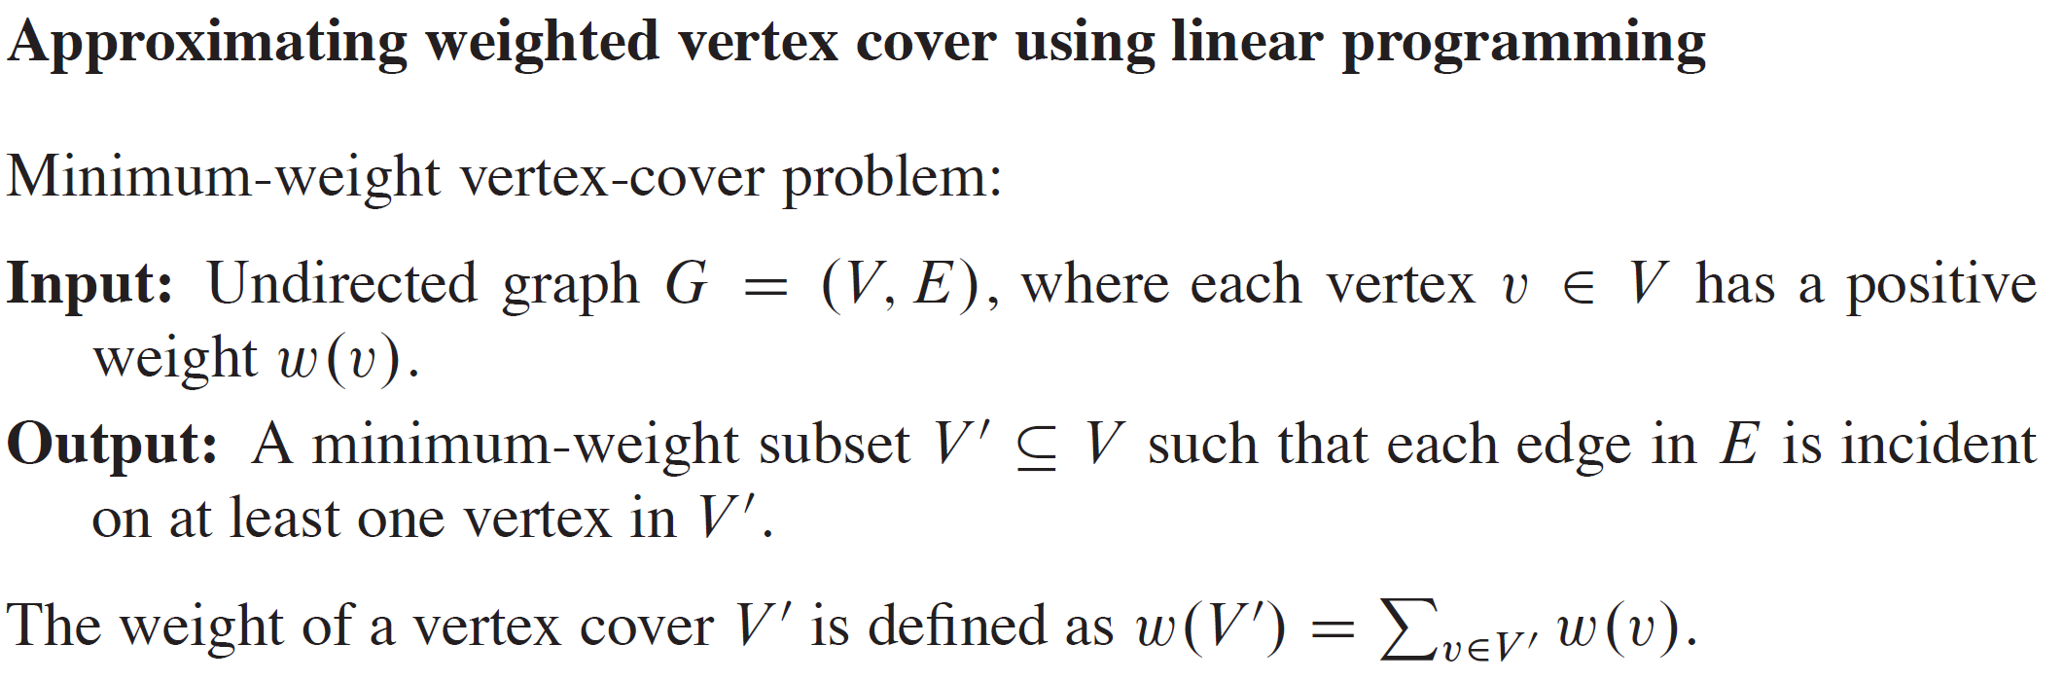
RANDOMIZATION AND LINEAR PROGRAMMING (continued)

Slide 24
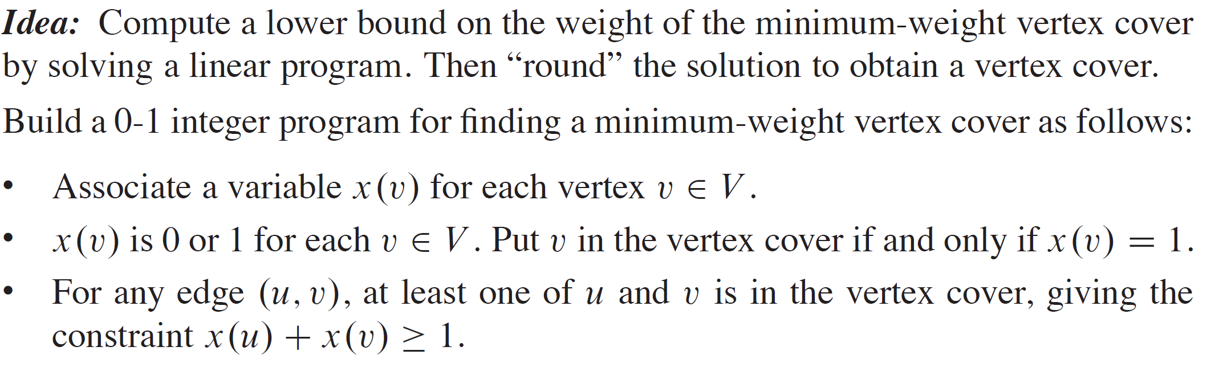
RANDOMIZATION AND LINEAR PROGRAMMING (continued)

Slide 25
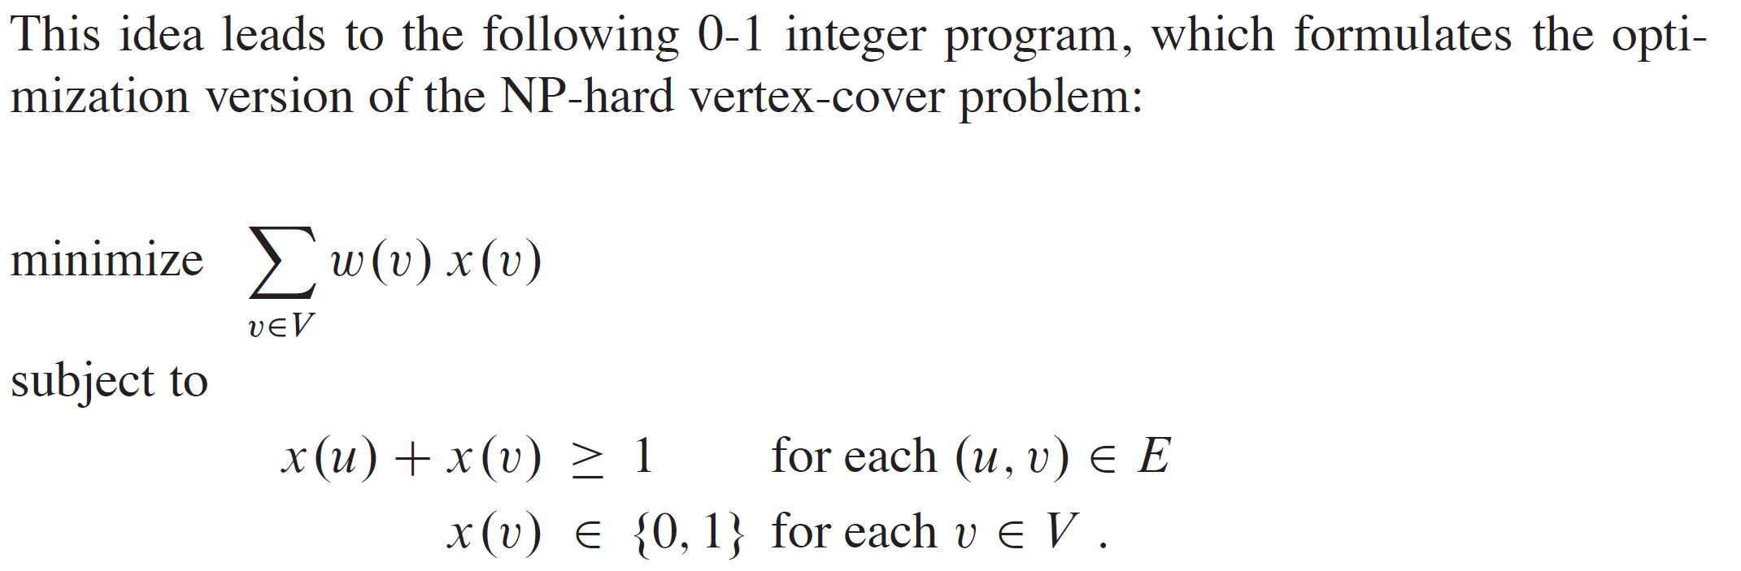
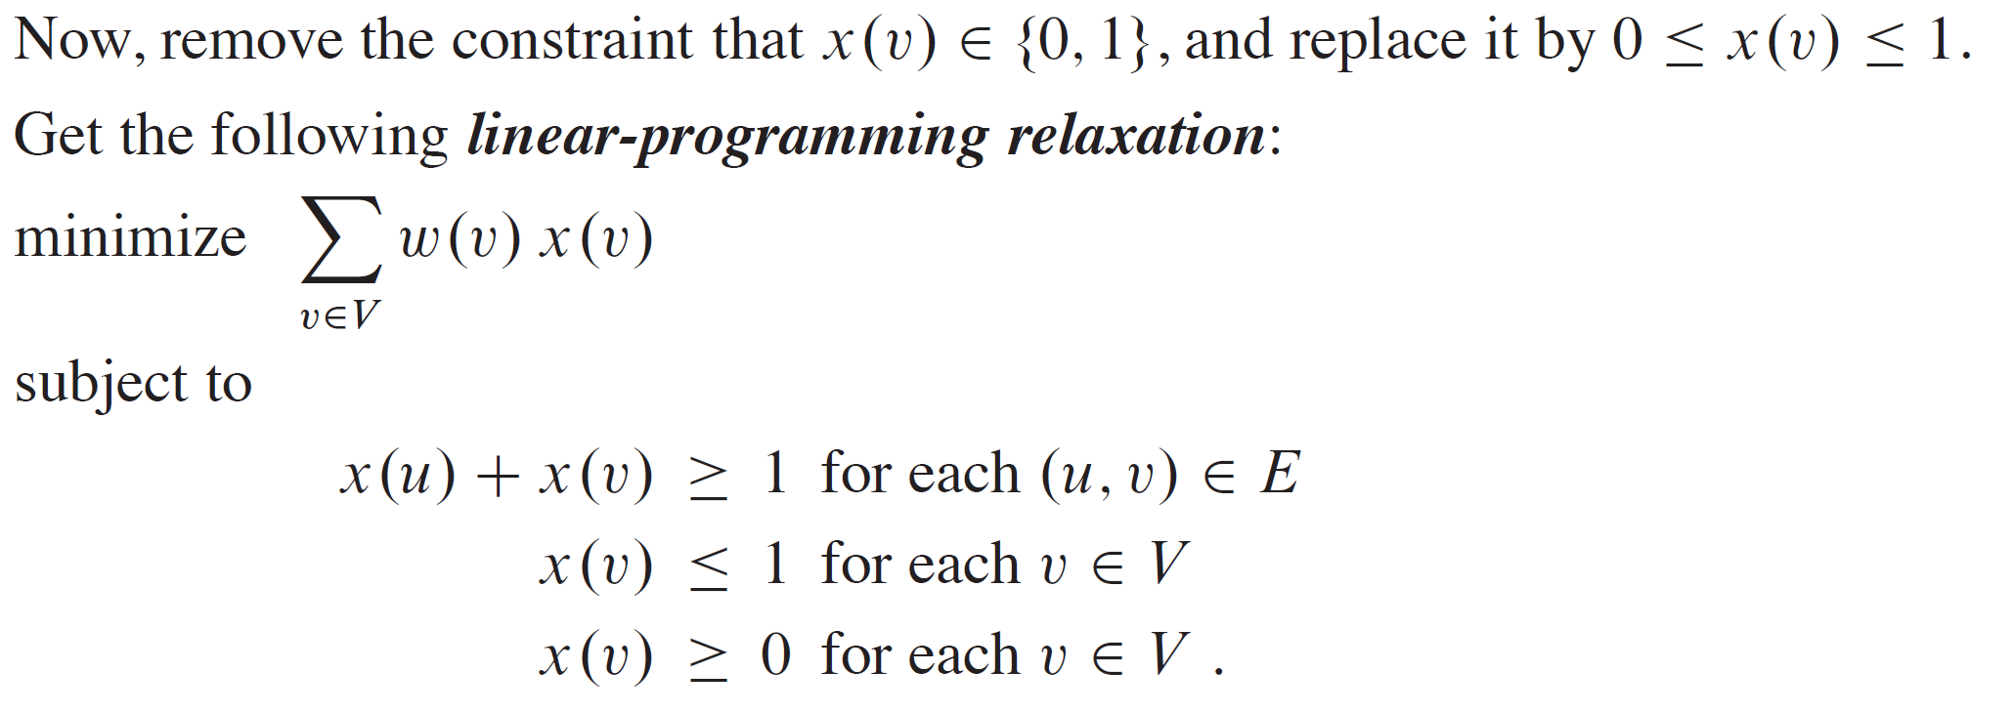
RANDOMIZATION AND LINEAR PROGRAMMING (continued)

Slide 26
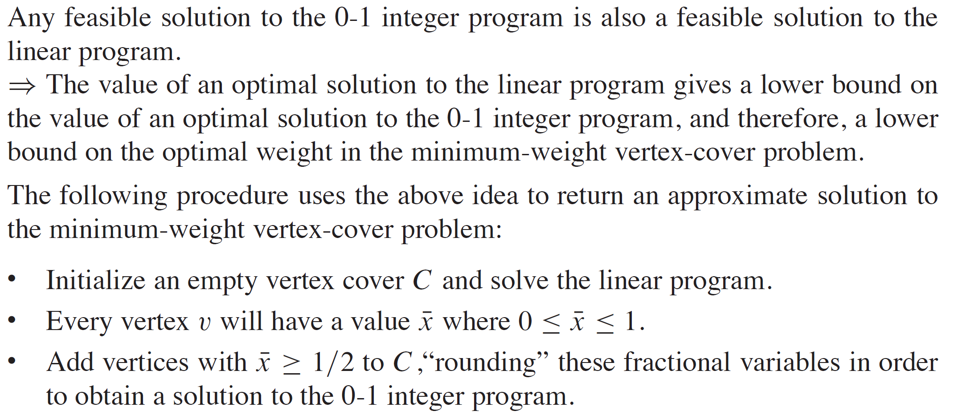
RANDOMIZATION AND LINEAR PROGRAMMING (continued)

Slide 27
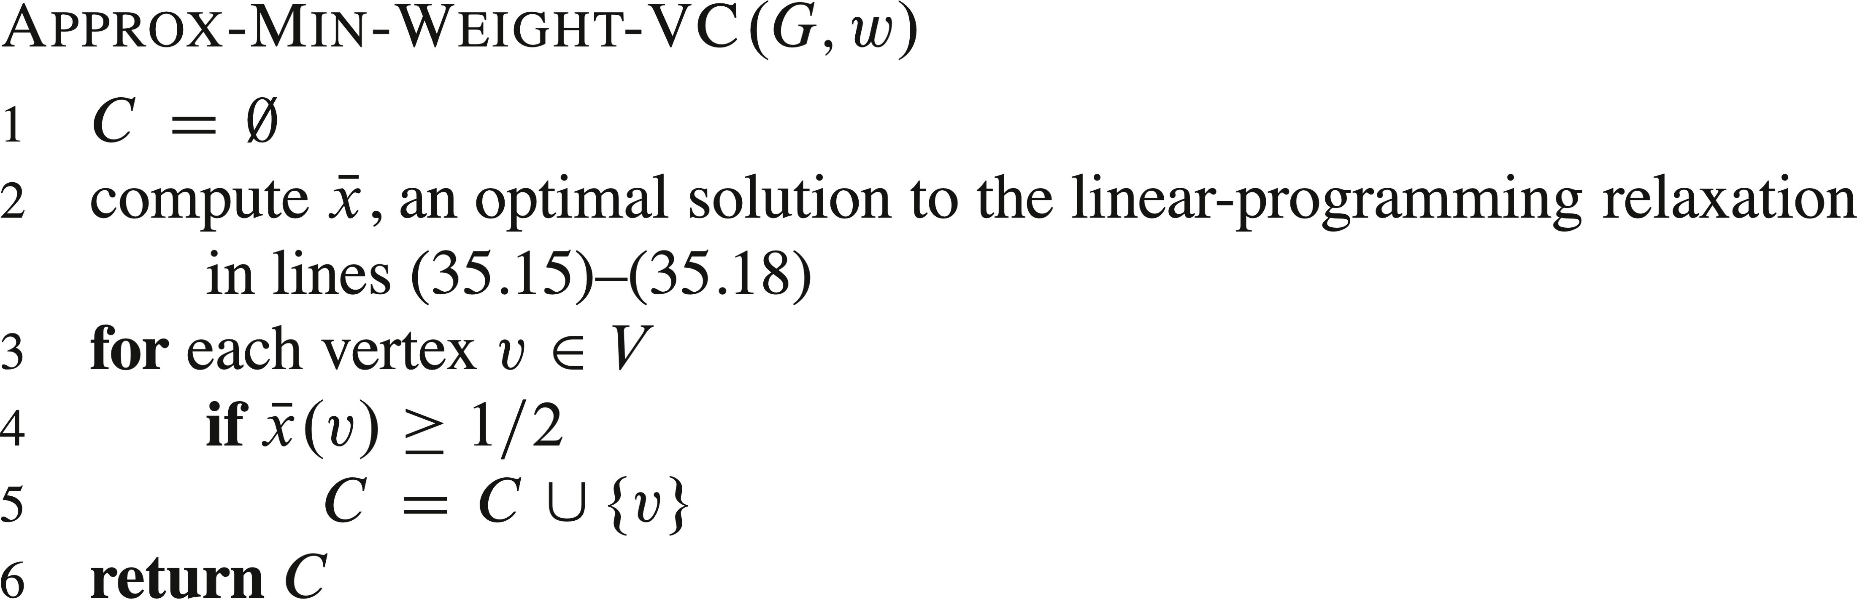
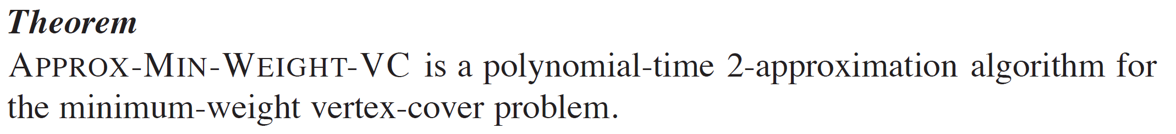
RANDOMIZATION AND LINEAR PROGRAMMING (continued)

Slide 28
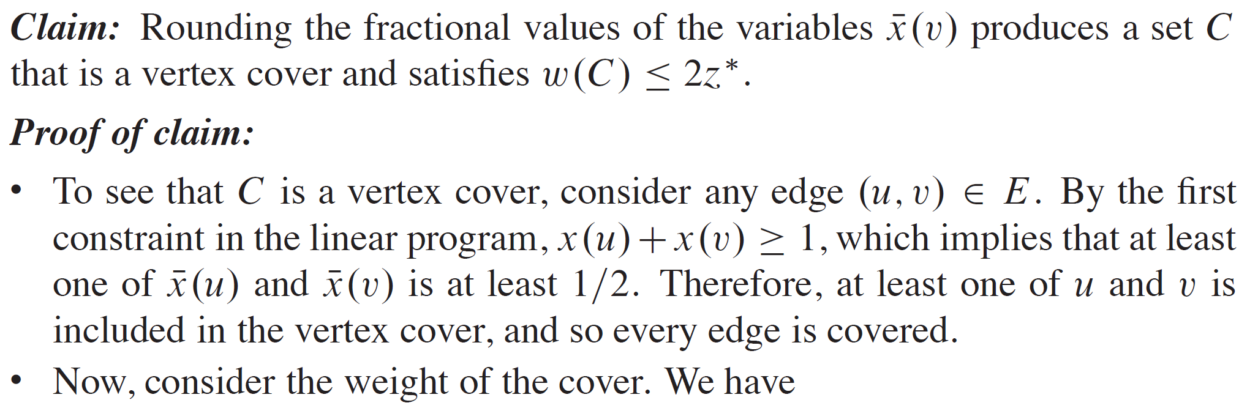
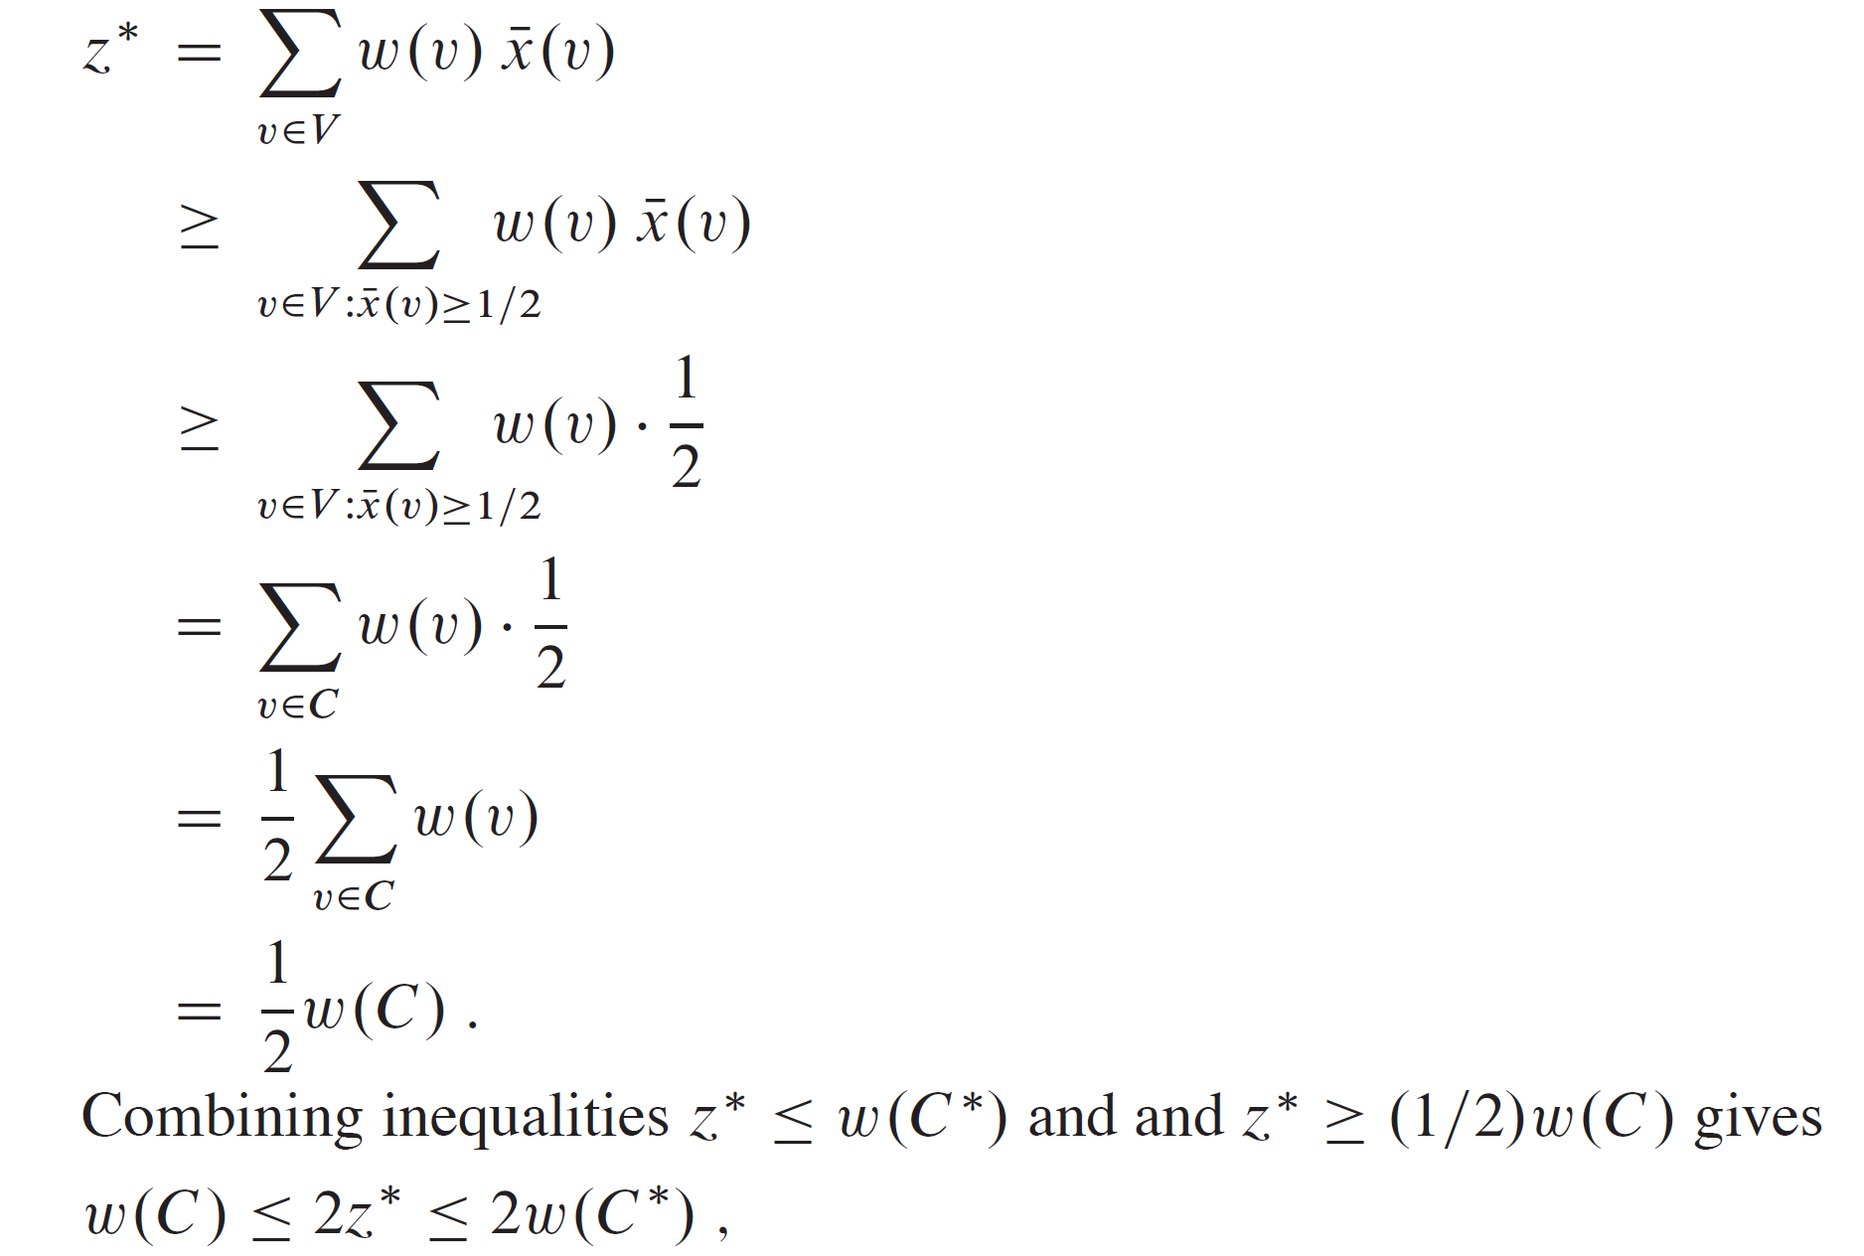
RANDOMIZATION AND LINEAR PROGRAMMING (continued)

Slide 29
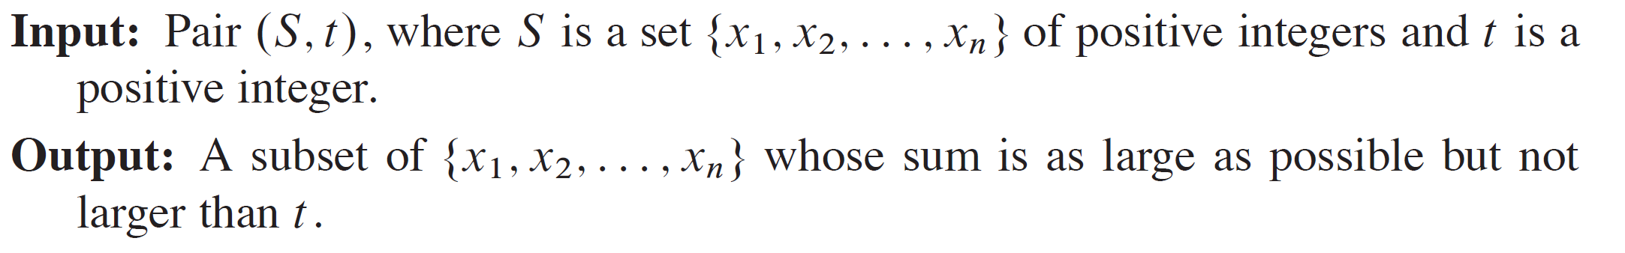
THE SUBSET-SUM PROBLEM

Slide 30
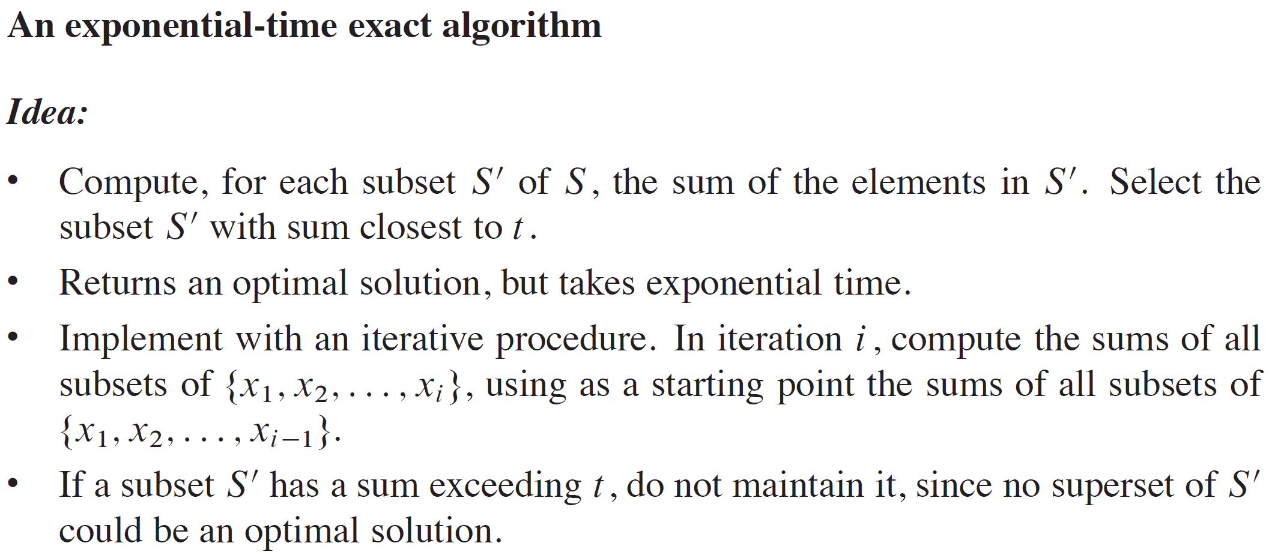
THE SUBSET-SUM PROBLEM (continued)

Slide 31
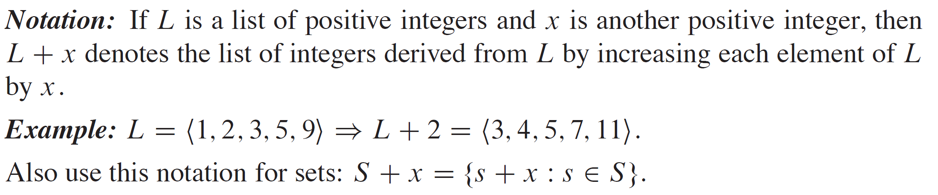
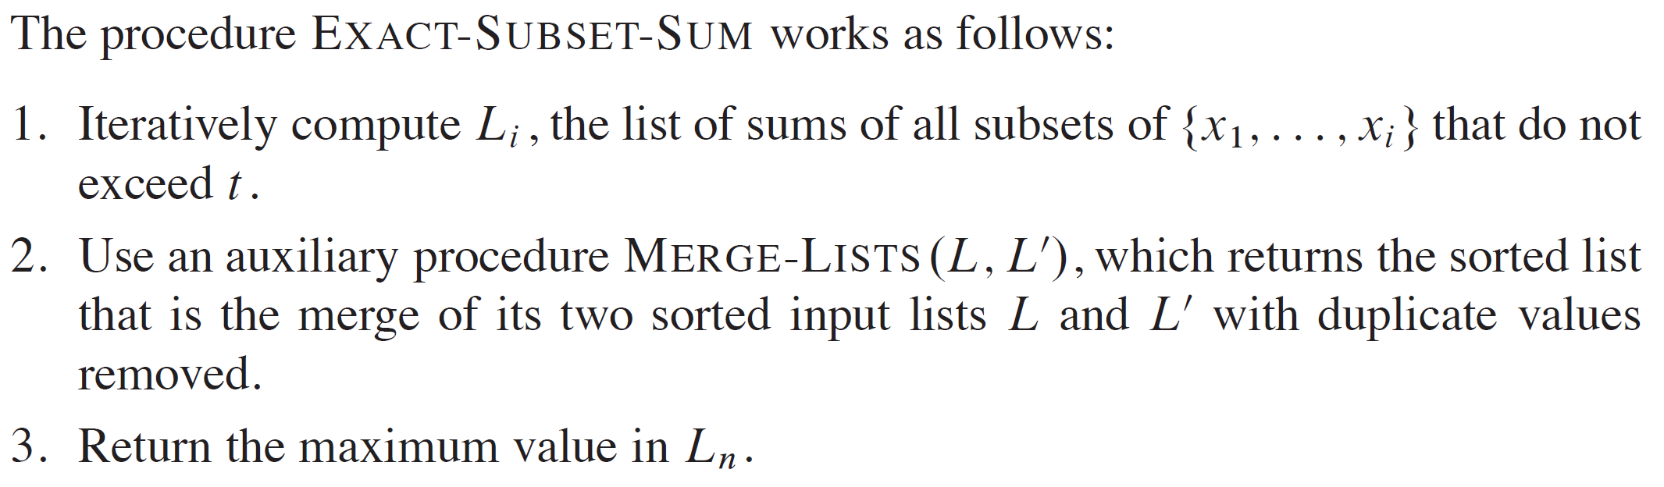
THE SUBSET-SUM PROBLEM (continued)

Slide 32
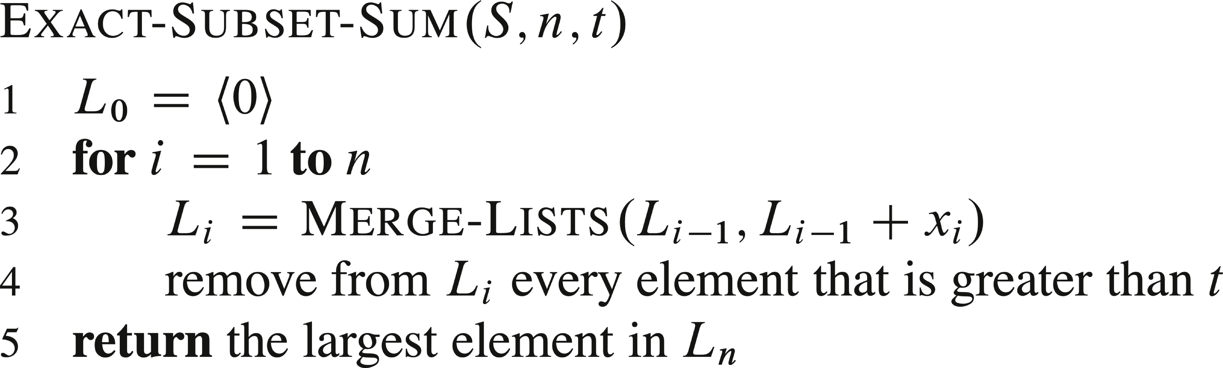
THE SUBSET-SUM PROBLEM (continued)

Slide 33
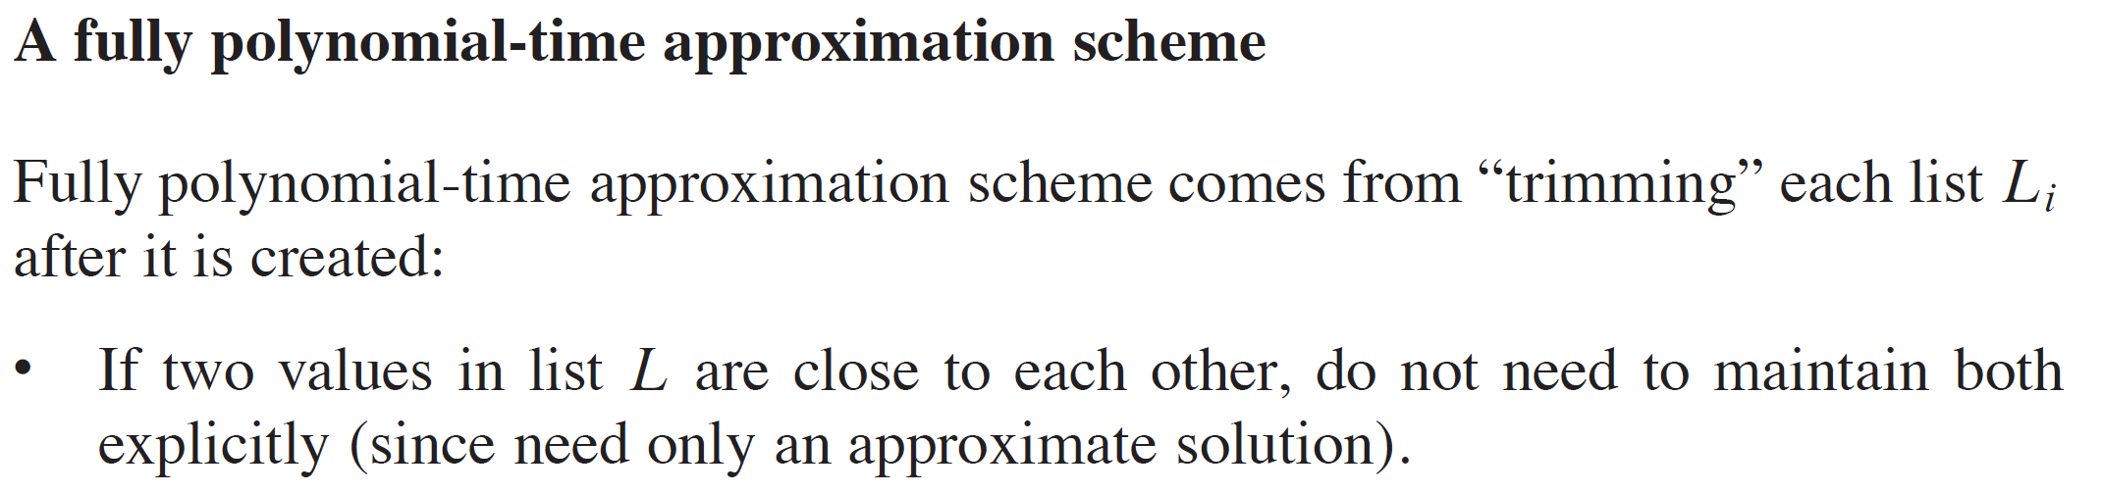
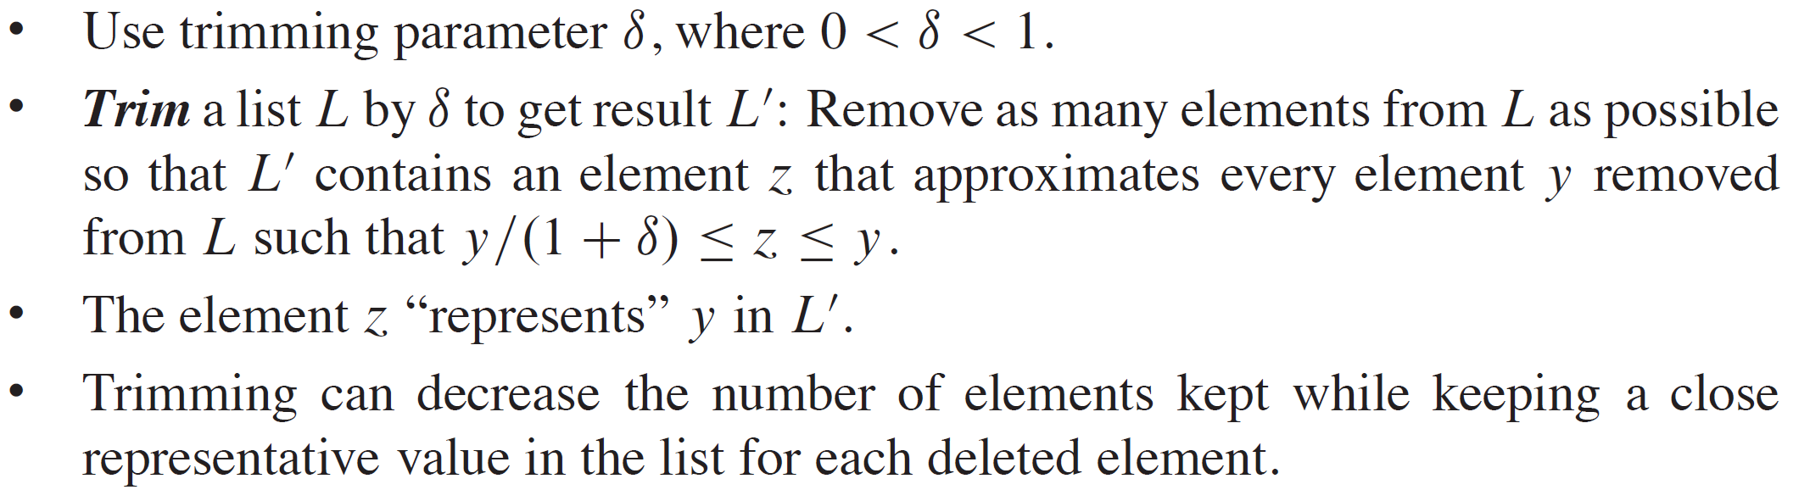
THE SUBSET-SUM PROBLEM (continued)

Slide 34
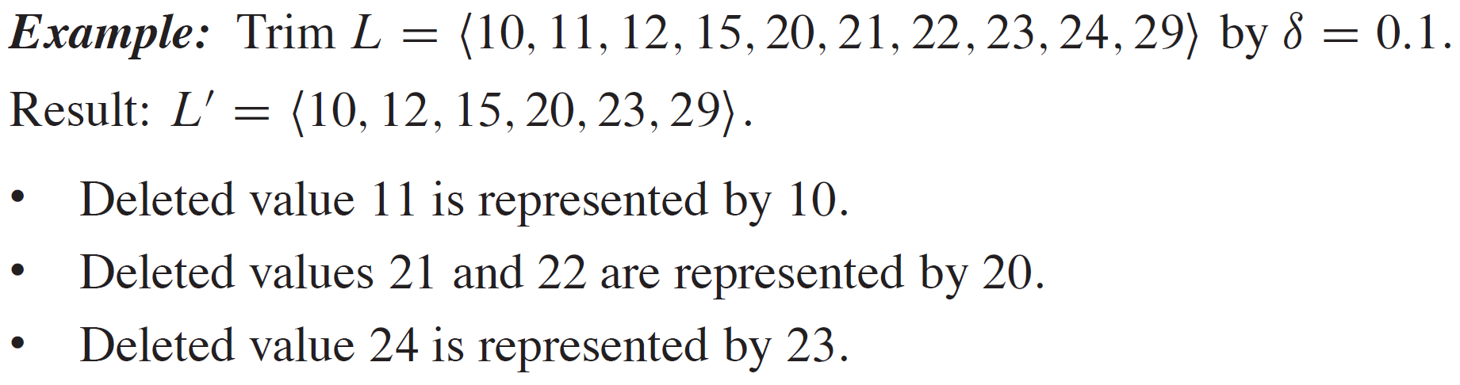
EXAMPLE

Slide 35
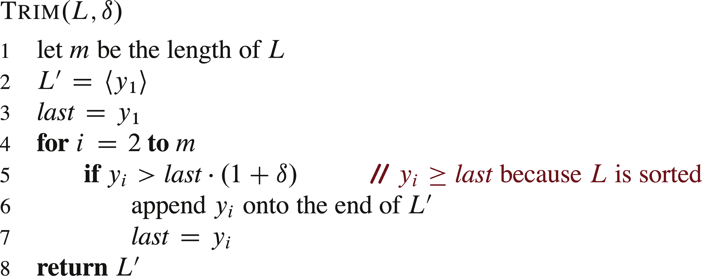
THE SUBSET-SUM PROBLEM (continued)

Slide 36
THE SUBSET-SUM PROBLEM (continued)

Slide 37
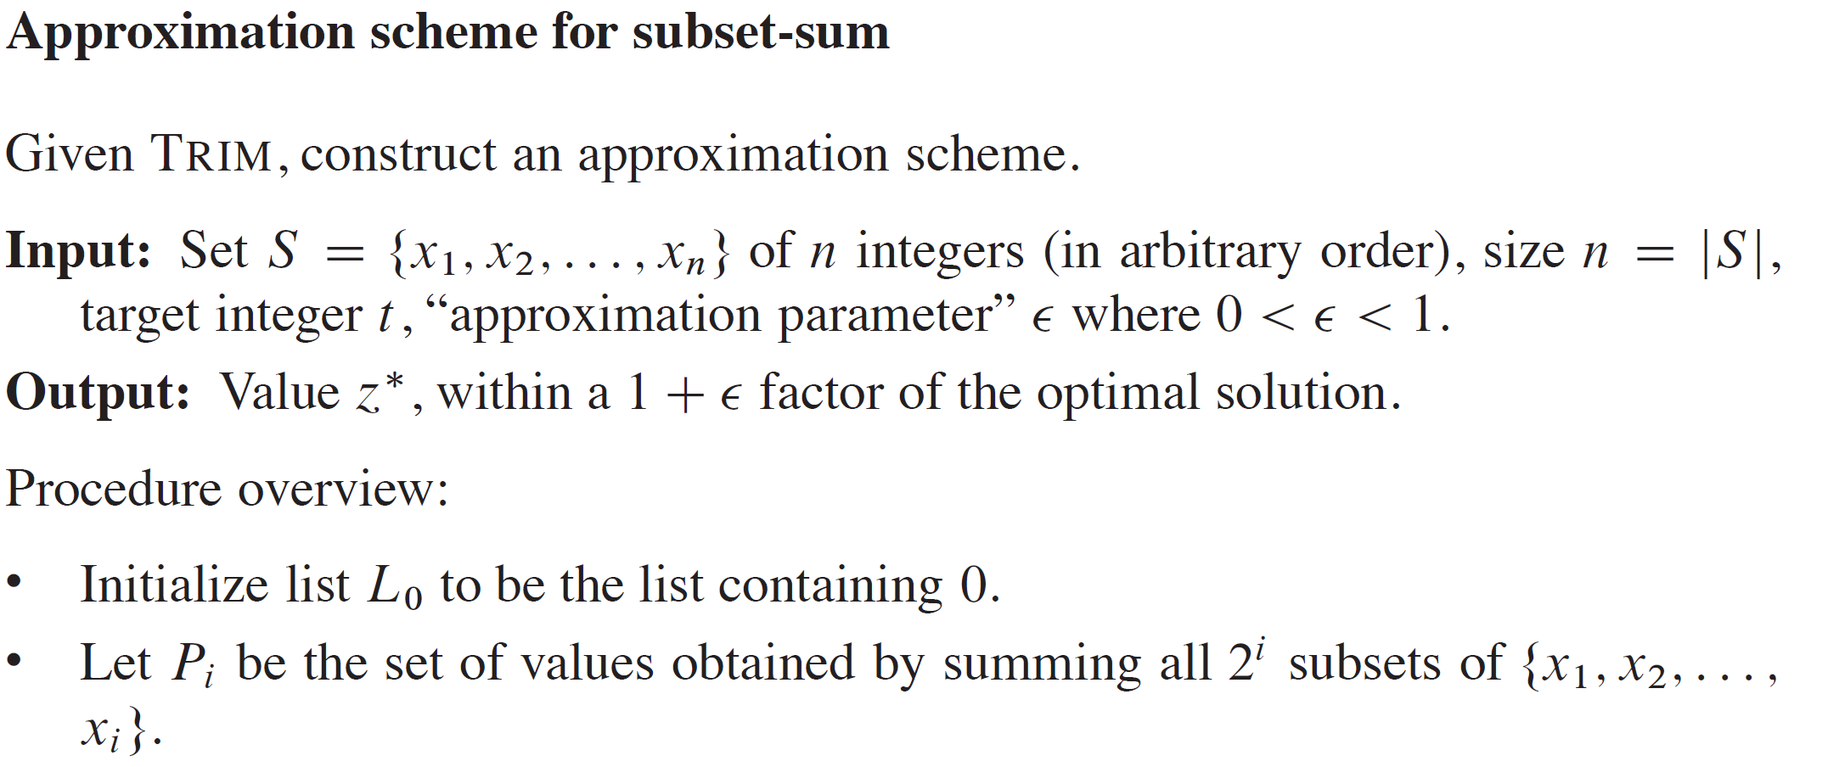
THE SUBSET-SUM PROBLEM (continued)

Slide 38
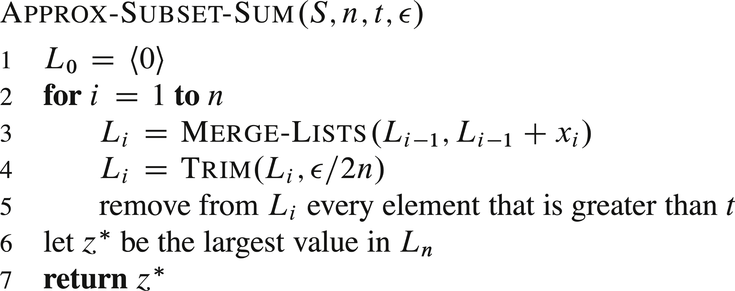
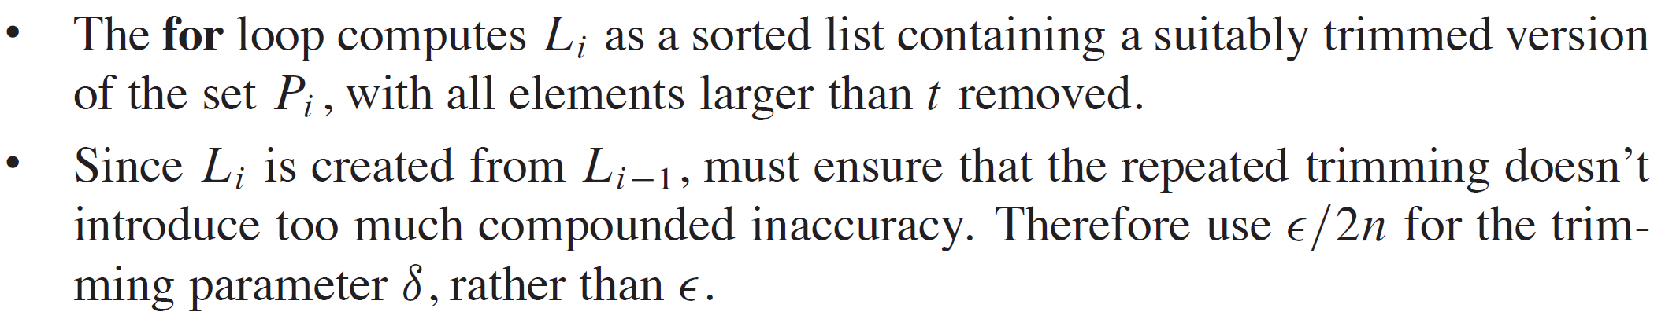
THE SUBSET-SUM PROBLEM (continued)

Slide 39
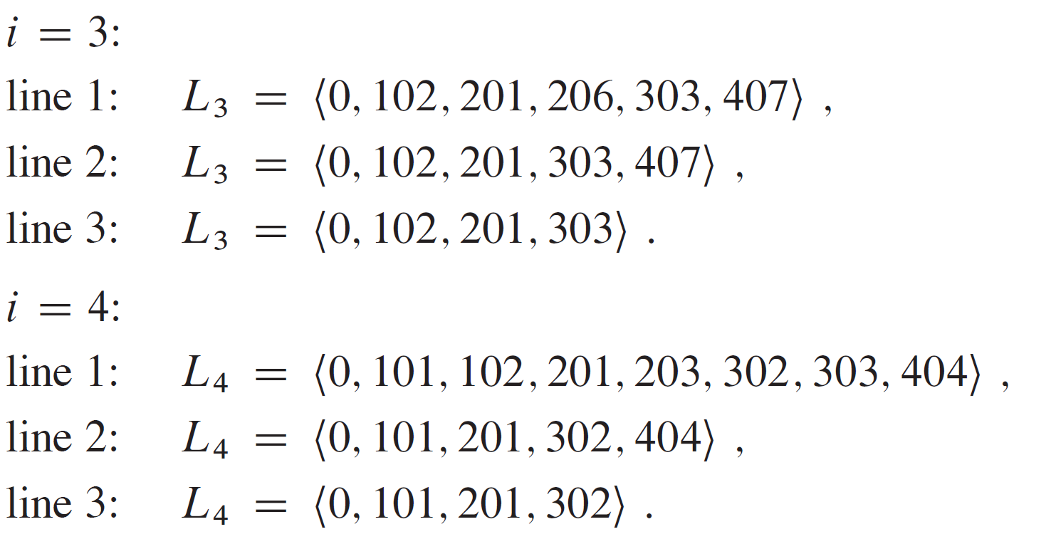
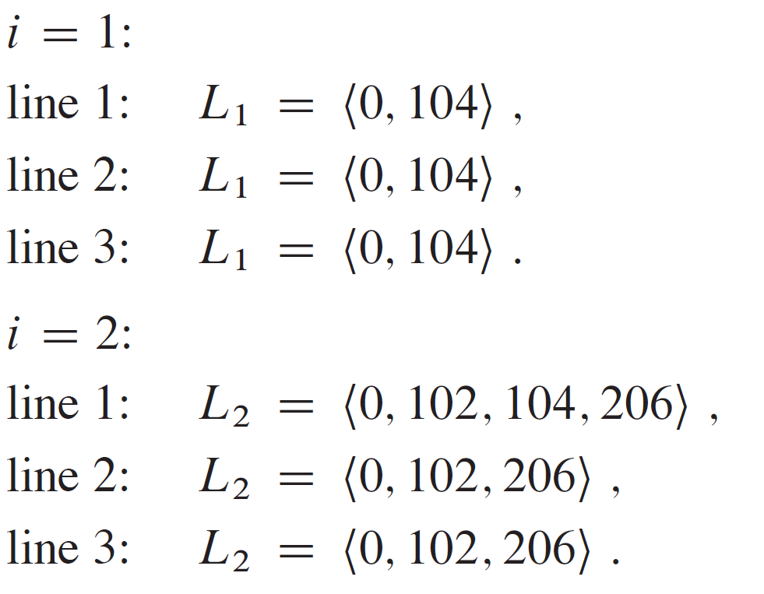

EXAMPLE

Slide 40

THE SUBSET-SUM PROBLEM (continued)

Slide 41


THE SUBSET-SUM PROBLEM (continued)

